Slide 1
CS F212 DBS Project Phase-1
Group 11
R Adarsh
Abhinav Bhattacharjee
Rishita Pandey
Satvik Sharma

Slide 2
Domain description
Library management system is an online portal that is maintained and operated by the library staﬀ and employee. The library staﬀ is responsible for maintaining details regarding books, reader information, penalty records etc.
(i) A library staﬀ/employee is registered with an authentication system that has login credentials of the employee. It may be possible that a some employees are not registered with authentication system. Every employee can have one and only one set of ID and password. The login ID is same as employee ID for the employee.
(ii) The library staﬀ regularly maintains record of members/readers registered with the library. Being an educational institution, there are 2 types of readers - Faculty and Student. Each faculty is uniquely identiﬁed by PSRN whereas student is identiﬁed uniquely by ID no. Additionally a reader is also provided with a registration id which uniquely identifies each reader. Every reader, be it faculty or student, has the following attributes: name(ﬁrst name, last name), branch/dept, email and contact. A reader can have more than one contact number.
(iii) The library staﬀ also maintains information of all books available in the library. Each book has following attributes: ISBN(unique), book title, author, category, status(derived),total copies.
(iv) A reader can issue/return books through system via the library staﬀ. The relationship between reader and book captures important details such as issue date, due date, return date, overdue charge of the particular book. The due date of any book can be fixed according to library rules. The reader cannot issue multiple copies of the same book on one day. A reader can issue max up to 6 books only.
(v) Details regarding penalty(if any, in case of overdue) is also recorded. The penalty charges will not be applicable for Faculty members. However, a student has to pay overdue charges in case of delay in returning books.

Slide 3
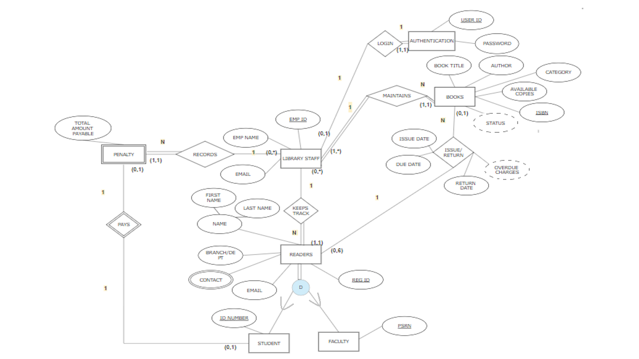

Slide 4
LIBRARY_STAFF
AUTHENTICATION SYSTEM
EMP_ID | EMP_NAME | EMAIL
USER_ID | PASSWORD
READERS
REG_ID | FIRST_NAME | LAST_NAME | BRANCH/DEPT | EMAIL | STAFF_ID
CONTACTS
REG_ID | PHONE
ISSUE/RETURN
REG_ID | ISBN | ISSUE_DATE | DUE_DATE | RETURN_DATE
STUDENT
FACULTY
REG_ID | ID_NO. | FIRST NAME | LAST NAME | BRANCH/DEPT | EMAIL
REG_ID | PSRN | FIRST NAME | LAST NAME | BRANCH/DEPT | EMAIL
BOOKS
ISBN | BOOK_TITLE | AUTHOR | CATEGORY | AVAILABLE COPIES | STAFF_ID
PENALTY
ID_NO. | TOTAL AMT. | STAFF_ID

